Slide 1
TDDD63 - Perspectives in Computer Science and Computer Engineering
Adam Andersson
Aleksi Evansson
Ludvig Westerdahl

Slide 2
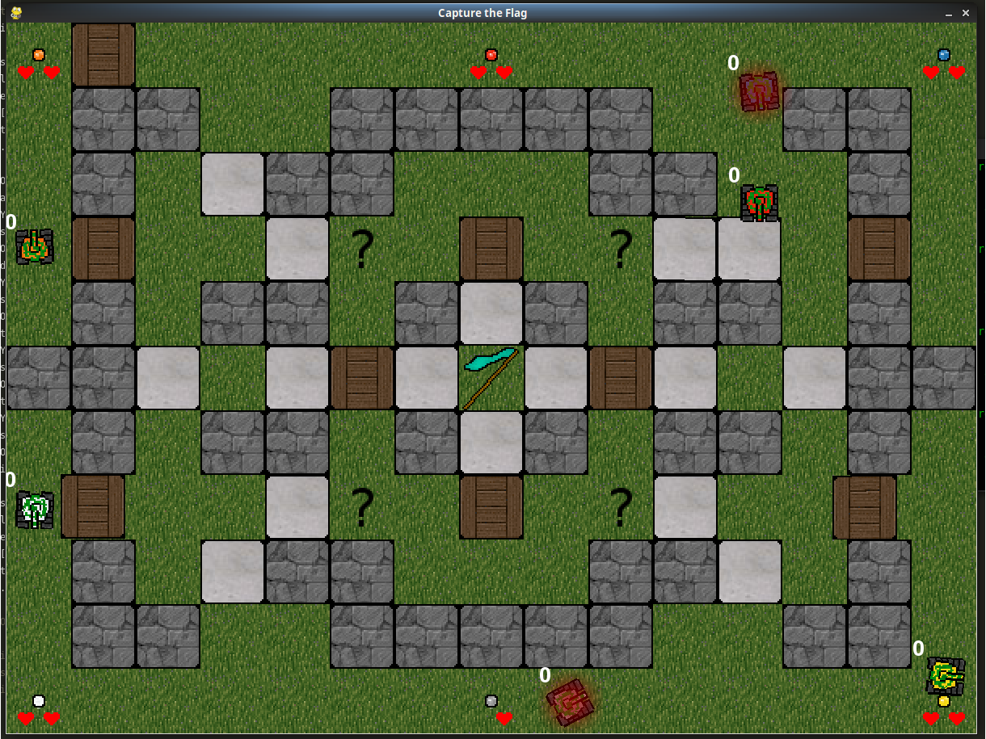
Capture the flag

Slide 3
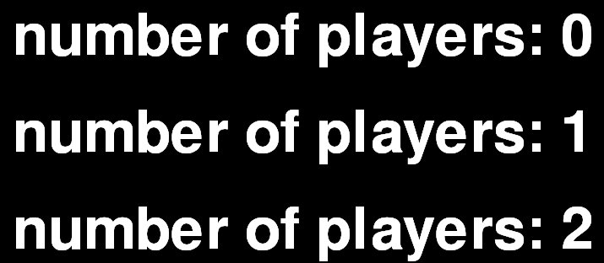
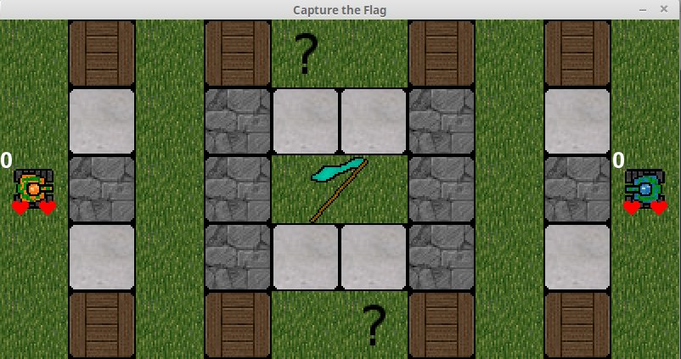
Starting a game
Menus
Maps
Multiplayer
Music

Slide 4
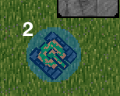
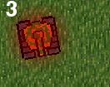
Gameplay
HP, score & holding flag
Spawn protection, overheated
Portals

Slide 5
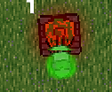
Powerups
Powerups
Increased or reduced speed
Extreme overheat
Increased damage
Sticky ammunition and automatic fire
Shield

